Slide 1
Anti-inflammatory & Pain-reducing drugs
Chapter 16

Slide 2
Basic Physiology
Inflammation is a useful and normal process that consists of a series of events, including vascular changes and release of chemicals that help destroy harmful agents at the injury site and repair damaged tissue
  Vasodilation increases permeability of blood vessels in the early phase (vascular phase)
  Accumulation of leukocytes, reduced blood flow, chemical release (histamine, prostaglandin, and bradykinin) and tissue damage in cellular phase (delayed phase)
Severe inflammation must be reduced to avoid additional damage to the body

Slide 3
Signs of Inflammation
Pain – due to tissue swelling and release of chemicals such as prostaglandin
Heat – due to increased blood accumulation and pyrogens (fever-producing substances) that interfere with temperature regulation
Redness – occurs in the early phase of inflammation due to blood accumulation in the area of tissue injury from chemical release (such as prostaglandins and histamine)

Slide 4
Signs of Inflammation
Swelling – occurs in delayed phase of inflammation because kinins dilate arterioles and increase capillary permeability. This increased capillary permeability allows plasma to leak into the interstitial tissue at the injury site.
Decreased Range of Motion – Function is lost due to fluid accumulation at the injury site. Pain also decreases mobility to an area.

Slide 5
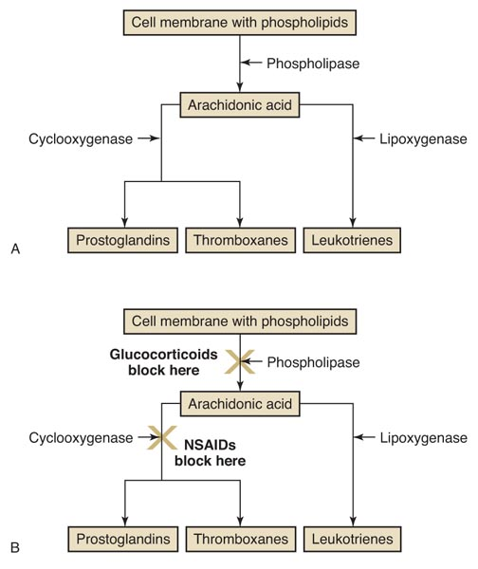
Anti-inflammatory Drugs
Two main groups of anti-inflammatory drugs
  Steroidal anti-inflammatory drugs block the action of phospholipase
  Nonsteroidal anti-inflammatory drugs block the action of cyclooxygenase

Slide 6
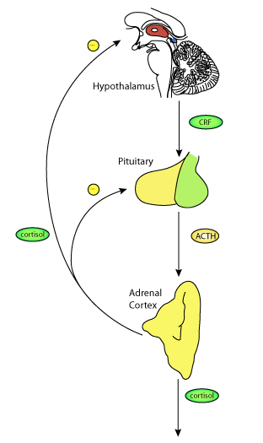
Steroidal Anti-inflammatories
Corticosteroids are hormones produced by the adrenal cortex
Two groups of corticosteroids used in veterinary medicine are the glucocorticoids and the mineralocorticoids

Slide 7
Glucocorticoids
Have anti-inflammatory effects due to their inhibition of phospholipase
Raise the concentration of liver glycogen and increase blood glucose levels
Affect carbohydrate, protein, and fat metabolism
Are regulated by negative feedback

Slide 8
Glucocorticoids
May be categorized as
  Short-acting (duration of action < 12 hours)
    Cortisone and hydrocortisone
  Intermediate-acting (duration of action 12–36 hours)
    Prednisone, prednisolone, prednisolone sodium succinate, methylprednisolone, methylprednisolone acetate, and triamcinolone
  Long-acting (duration of action > 36 hours)
    Dexamethasone, betamethasone, and fluocinolone
May be given orally, parenterally, or topically

Slide 9
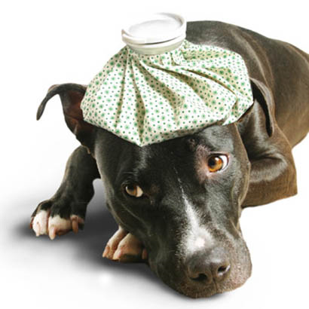
Glucocorticoid Use
Benefits:
  Reduce inflammation and pain
  Relieve pruritus
  Reduce scarring by delaying wound healing
  Reduce tissue damage
Drawbacks:
  Delay wound healing
  Increase risk of infection
  May cause GI ulceration and bleeding
  Increase the risk of corneal ulceration if corneal damage exists
  May induce abortion in some species

Slide 10
Key Points About
Glucocorticioid Treatment
Glucocorticoids do not cure disease
They may exacerbate infectious diseases
Use caution when giving high dosages of glucocorticoids to pregnant animals
Whenever possible, use the topical form to avoid systemic imbalances
Use alternate-day dosing at the lowest possible doses to prevent iatrogenic Cushing’s disease
Taper animals off glucocorticoids to prevent iatrogenic Addison’s disease
Do not use glucocorticoids in animals that have corneal ulcers

Slide 11
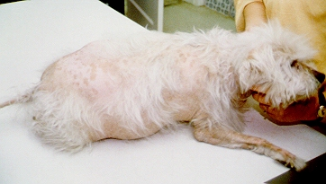
Cushing’s Disease (hypoadrenocorticism)

Slide 12
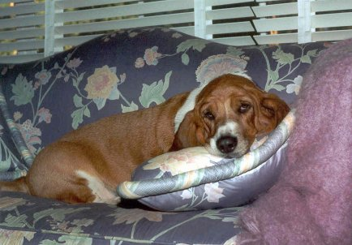
Addison’s Disease (hypoadrenocorticism)

Slide 13
Non-Steroidal Anti-inflammatory Drugs
NSAIDs work by inhibiting cyclooxygenase, which has two forms
  Cox-1 is involved with the stomach
  Cox-2 is involved with inflammation
NSAIDs are also referred to as prostaglandin inhibitors
NSAIDs have fewer side effects than glucocorticoid drugs
Side effects of NSAIDs include GI ulceration and bleeding and bone marrow suppression

Slide 14
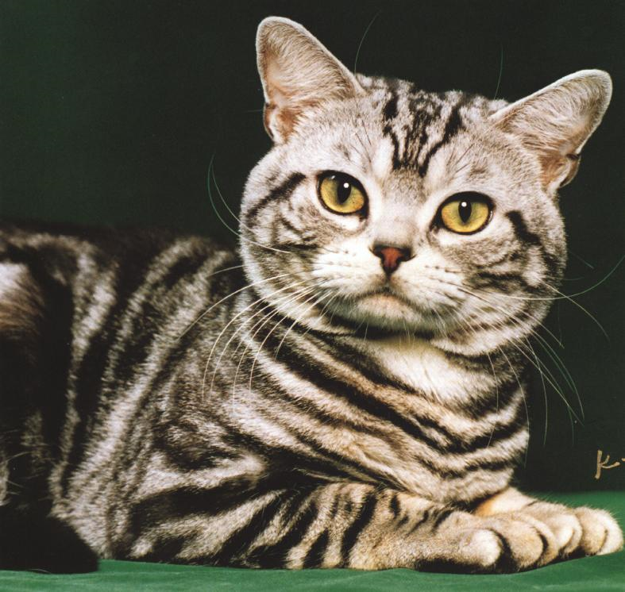
NSAIDs
Aspirin is an analgesic, fever reducer,
anti-inflammatory, and a reducer of platelet aggregation
Aspirin must be used with caution in cats because they can’t metabolize it as fast as other species
If used on a cat, Aspirin is given in lower dosages less frequently

Slide 15

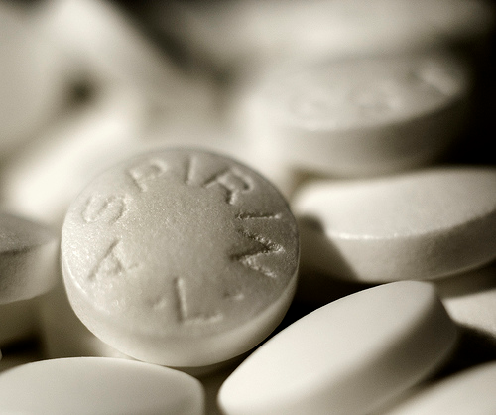
NSAIDs
The use of Aspirin by animal owners may lead to a toxicity levels which rise over time
Signs of salicylate toxicity include:
  Gastrointestinal problems
    Anorexia, abdominal pain, vomiting, diarrhea
  Respiratory problems
    Panting
  Neurological problems
    Restlessness, anxiety, seizures
  Bleeding problems
  Kidney failure

Slide 16
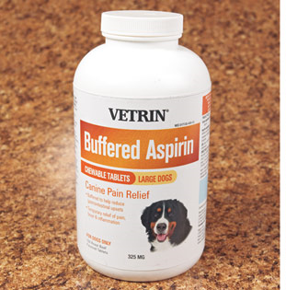
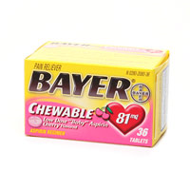
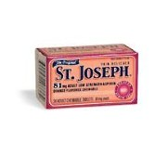
Types of NSAIDs
Salicylates - Aspirin
  Potent inhibitors of prostaglandin synthesis; include drugs such as aspirin
  Aspirin is an analgesic, antipyretic, and anti-inflammatory
  Side effects include gastrointestinal problems

Slide 17
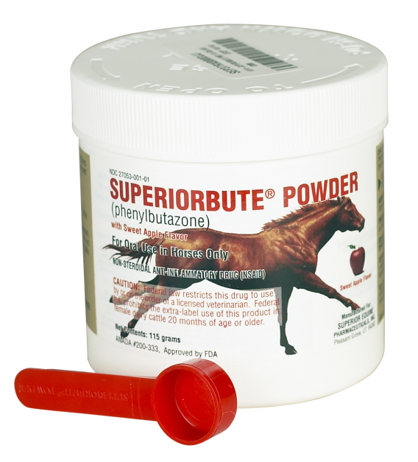
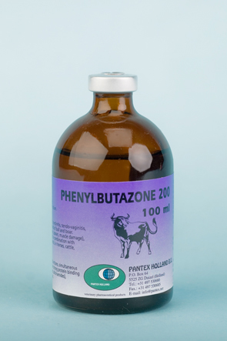
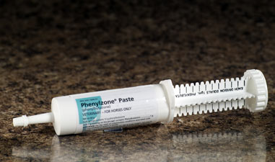
Types of NSAIDs
Pyrazolone derivatives
  Inhibit prostaglandin synthesis
  Phenylbutazone is an analgesic, antipyretic, and anti-inflammatory
  Used in equine medicine for musculoskeletal pain
  Phenylbutazone (“bute”)
    Frequently used in equine medicine for musculoskeletal pain.

Slide 18
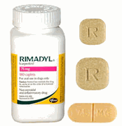
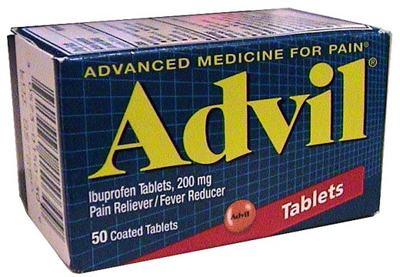
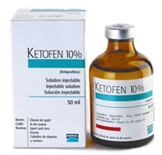
Types of NSAIDs
Propionic acid derivatives
  Block both cyclooxygenase and lipoxygenase
  Examples include ibuprofen, ketoprofen, carprofen, and naproxen (the –fen drugs)
  Side effects include gastrointestinal problems and possible liver toxicities

Slide 19
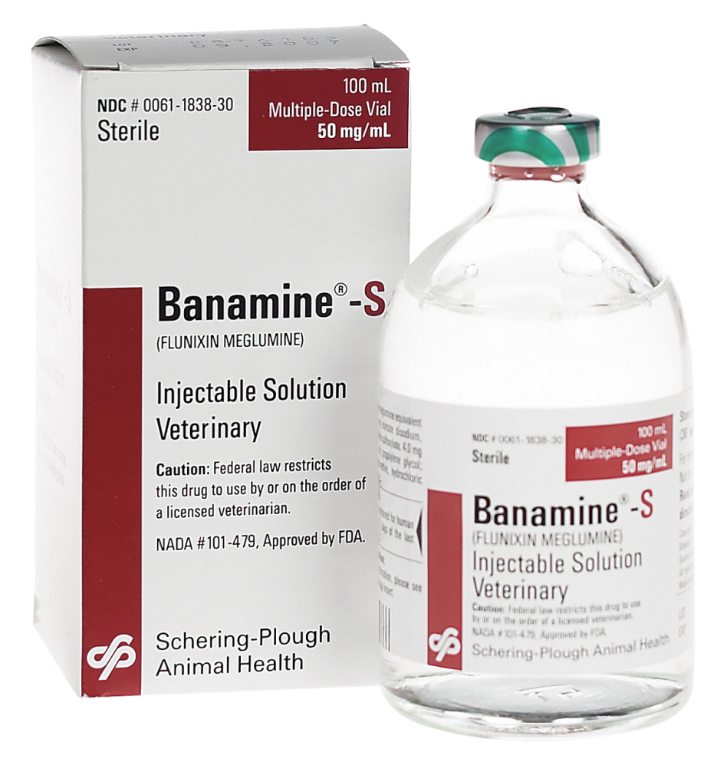
Types of NSAIDs
Flunixin meglumine
  Inhibits cyclooxygenase
  Used in cattle and horses for musculoskeletal and colic pain
  Is a potent analgesic, antipyretic, and anti-inflammatory

Slide 20
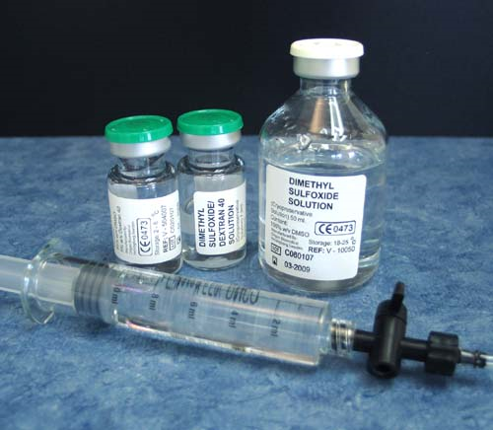
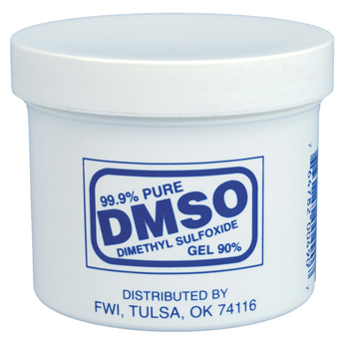
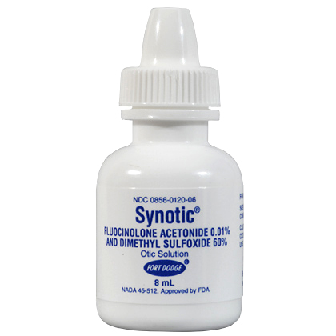
Types of NSAIDs
Dimethyl sulfoxide (DMSO)
  Inactivates superoxide radicals produced by inflammation
  Is also able to penetrate skin and serve as a carrier of other drugs (may cause burning)
  Must use caution when applying

Slide 21
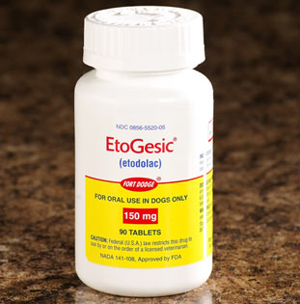
Type of NSAIDs
Indol acetic acid derivatives
  Inhibit cyclooxygenase (more selective for Cox-2)
  Is an analgesic and anti-inflammatory
  An example is etodolac (Etogesic®), which has the benefit of once-a-day dosing

Slide 22
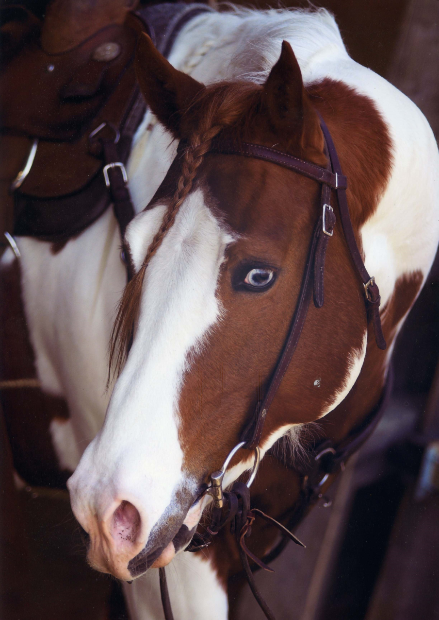
Types of NSAIDs
Fenamates
  Inhibit cyclooxygenase
  Are analgesics and anti-inflammatories
  An example is meclofenamic acid (Arquel®)

Slide 23
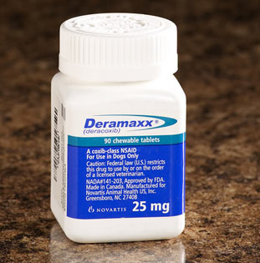
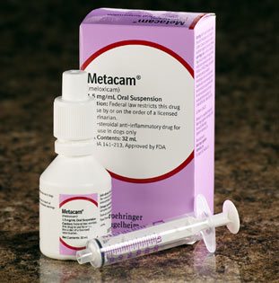
Types of NSAIDs
Cox-2 inhibitors
  Inhibit cyclooxygenase-2 without interfering with the protective cyclooxygenase-1
  Examples include deracoxib and meloxicam
  Side effect include anorexia, vomiting, and lethargy

Slide 24
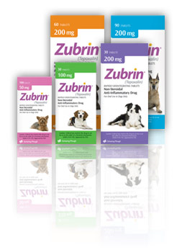
Types of NSAIDs
Dual-pathway NSAIDs
  Block arachidonic acid cycle (both cyclooxygenase and lipoxygenase pathways)
  Are analgesics and anti-inflammatories
  An example is tepoxalin (Zubrin®), which is a rapidly disintegrating tablet used for osteoarthritis in dogs

Slide 25
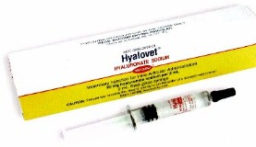
Other Osteoarthritis Treatments
Glycosaminoglycans: proteoglycans form part of the extracellular matrix of cartilage. Polysaccharide groups in proteoglycans are called glycosaminoglycans (GAGs).
  Hyaluronic acid: part of joint fluid; given intra-articularly, helps cushion degenerating joints
    Local reactions may occur but usually resolve 24-48 hrs

Slide 26
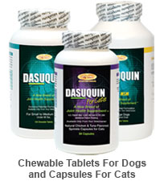
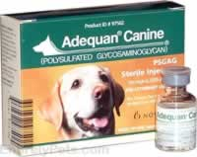
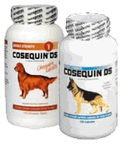
Other Osteoarthritis Treatments
  Polysulfated glycosaminoglycans: semisynthetic mix of GAGs from bovine cartilage. Helps promote production of joint fluid and has anti-inflammatory effects
  Glucosamine and chondroitin sulfate: believed to play a role in the maintenance of cartilage
    Neutraceutical

Slide 27
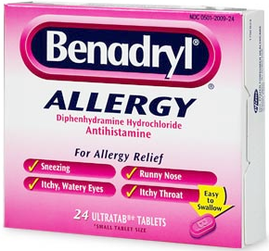
Antihistamines
Antihistamines counteract the effect of histamine (histamine cause bronchoconstriction and inflammatory changes)
Antihistamines compete with histamine for receptor sites (H₁ receptors constrict smooth muscles and H₂ receptors increase gastric secretions)
H₁ blockers are used to treat pruritus, laminitis, motion sickness, anaphylactic shock, and some upper respiratory conditions
Examples include diphenhydramine, dimenhydrinate, chlorpheniramine, pyrilamine maleate, tripelennamine, terfenadine, hydroxyzine, and meclizine

Slide 28
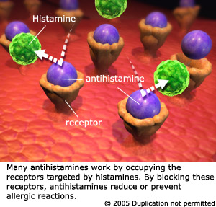

Slide 29
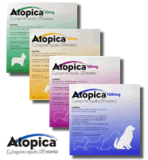
Immunomodulators
Immunomodulation is the adjustment of the immune system to a desired level.
Immunosuppression is reducing the immune response.
Cyclosporine (Atopica®) is one of the most effective immunosuppressant agents available.
  Suppresses T-lymphocyte activity
  Anti-inflammatory and anti-pruritic properties
  Developed for atopic dermatitis in dogs
  Must treat bacterial and fungal infections before use

Slide 30
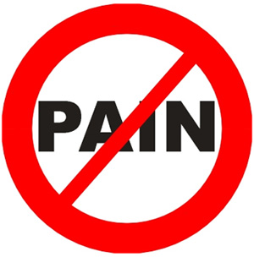
Analgesics
Analgesics are drugs that relieve pain without causing loss of consciousness
Analgesics fall into two categories:
  Narcotics
  Non-narcotics:
    Aspirin
    Pyrazolone derivatives
    Propionic acid derivatives
    Flunixin meglumin
    Indol acetic acid derivatives
    Meclofenamic acid

Slide 31
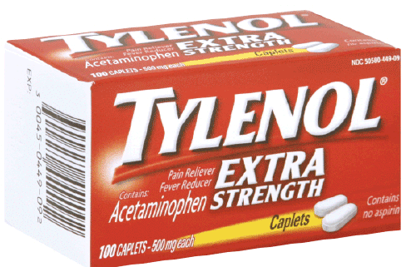
Analgesics
Acetaminophen is another non-narcotic analgesic, which includes the drug Tylenol
  Rarely used in veterinary medicine unless combined with codeine
  Reduces fever and likely reduces the perception of pain
  Gastrointestinal side effects are rare but it can cause liver and kidney dysfunction in all animals

Slide 32
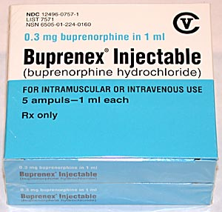
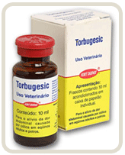
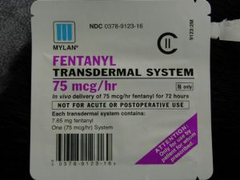

Slide 33
Selection of an analgesic is based on:
Effectiveness of the agent
  Mild to moderate: NSAIDs
  Severe: opioids
Duration of action
  Post-op pain vs. osteoarthritis (chronic)
Duration of therapy
  Some analgesics are highly effective but harmful with prolonged use.
Available routes of drug administration
  Oral therapy = most common/convenient for owners

